Slide 1
Introduction to Data Science

Slide 2
Table of Contents
What is Data Science?
Examples of problems
Data Science/ML/AI
Brief History of ML
Current achievements
What’s next?

Slide 3
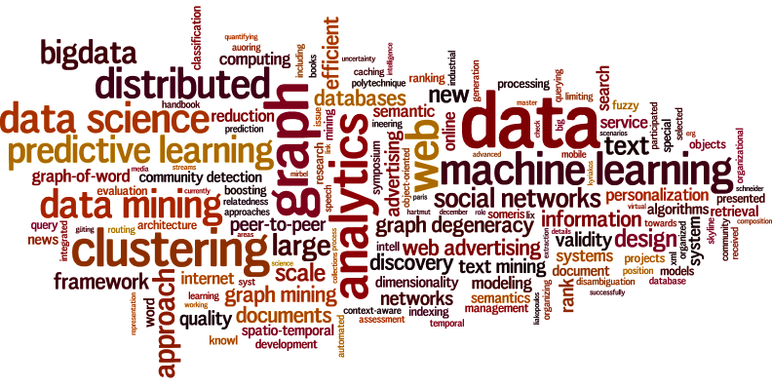
What is Data Science?

Slide 4

What is Data Science?
Data Science solves real life problems using data.

Slide 5
Examples of Problems
Object Classification/Detection/Segmentation
Forecasting
Autonomous Vehicles
Sentiment Analysis
Generating Stories

Slide 6
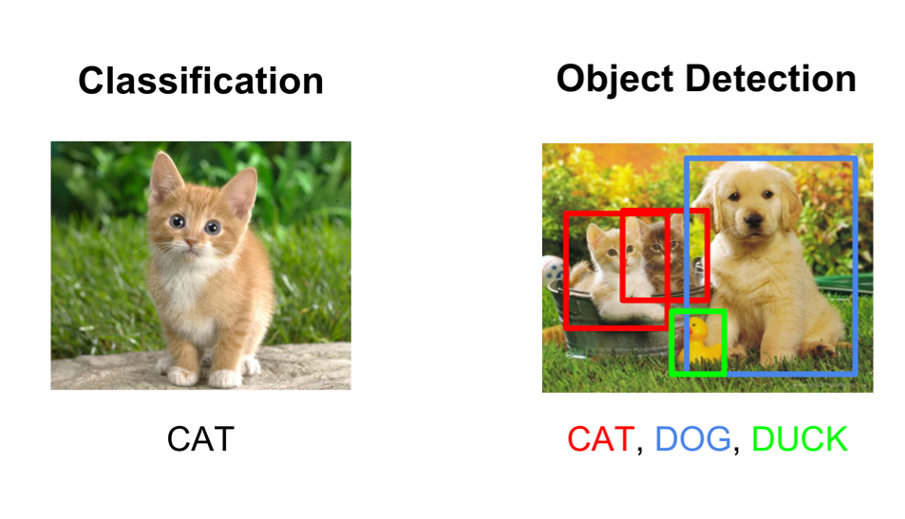
Examples of Problems (Object Classification)

Slide 7
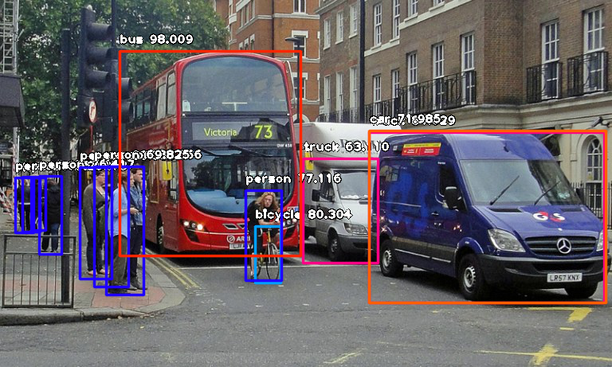
Examples of Problems (Object Detection)

Slide 8

Examples of Problems (Object Detection)

Slide 9
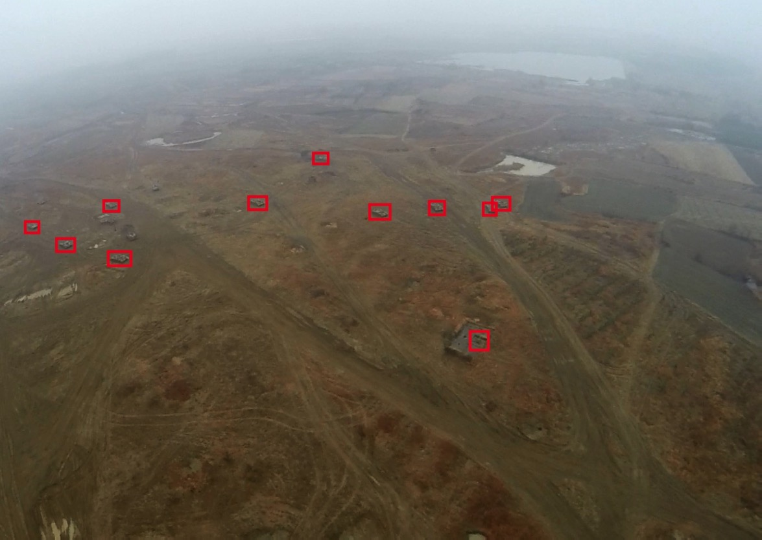
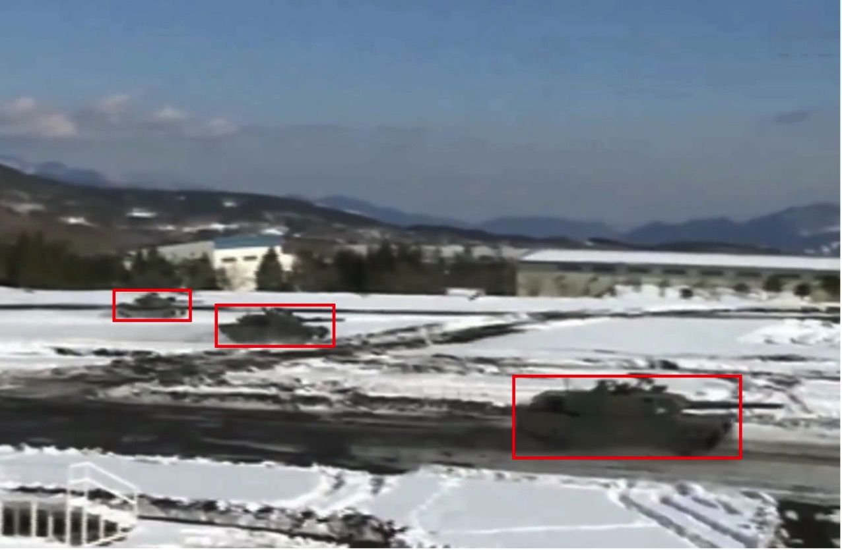
Examples of Problems (Object Detection)
Paper Link: https://www.worldscientific.com/doi/pdf/10.1142/S0218001419500071

Slide 10
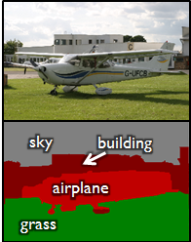
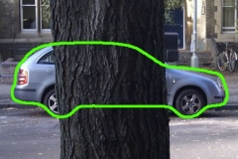
Examples of Problems (Object Segmentation)

Slide 11
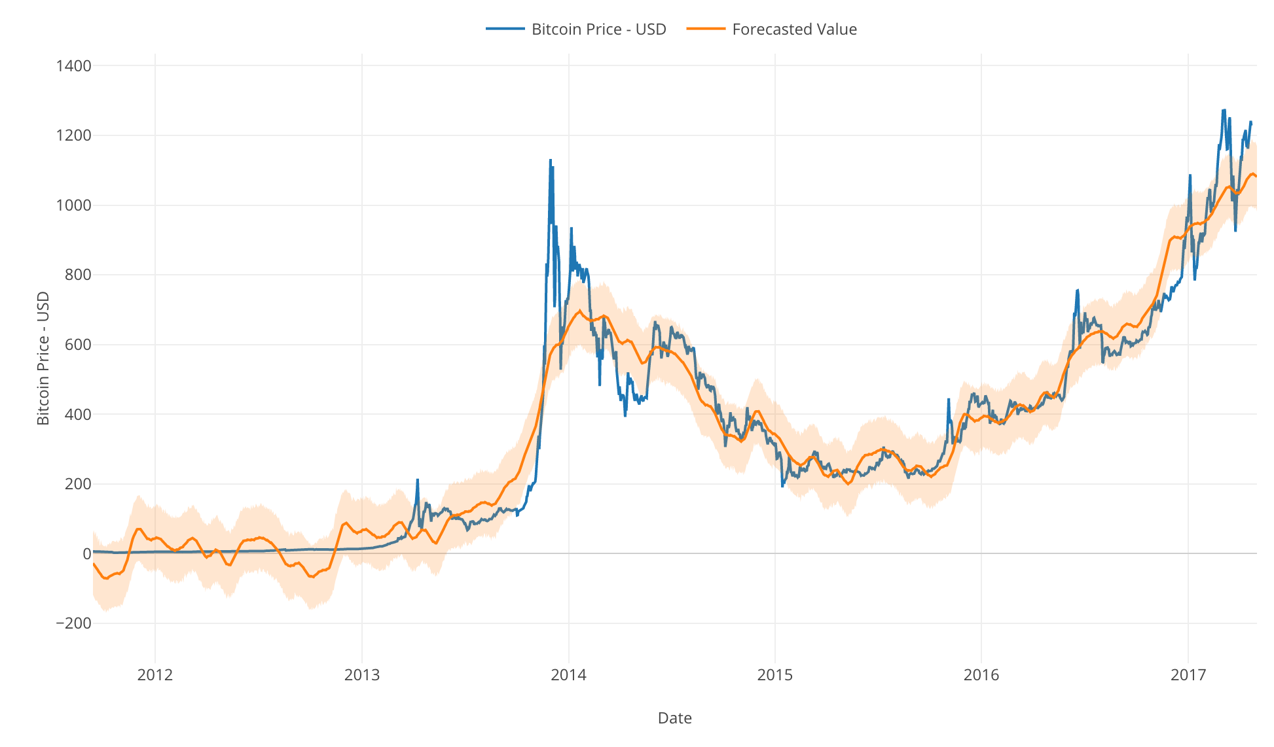
Examples of Problems (Forecasting)

Slide 12

Examples of Problems (Autonomous Vehicles)

Slide 13
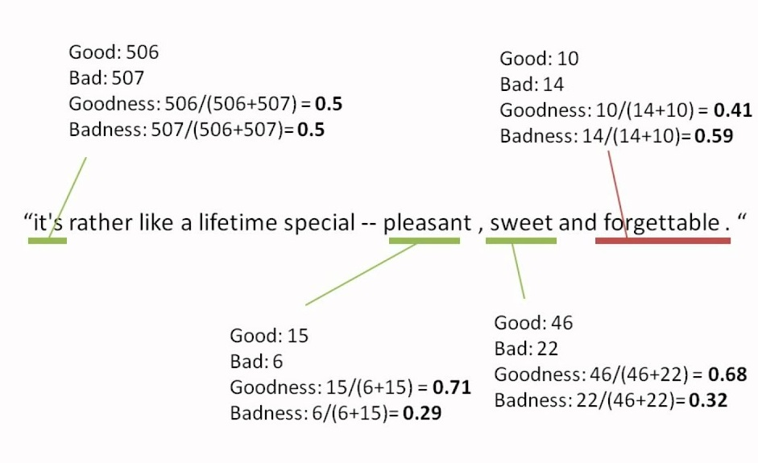
Examples of Problems (Sentiment Analysis)

Slide 14

Examples of Problems (Generating Stories)
A snippet generated by NN:
Jaime killed Cersei and was cold and full of words, and Jon thought he was the wolf now, and white harbor...
https://motherboard.vice.com/en_us/article/evvq3n/game-of-thrones-winds-of-winter-neural-network

Slide 15
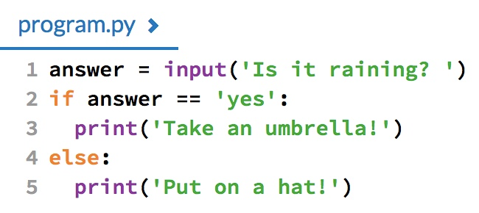
Data Science/ML/AI
AI is a general term for defining non-human intelligence. A simple if statement can also be an AI.

Slide 16
Data Science/ML/AI
Machine learning (ML) is the scientific study of algorithms and statistical models that computer systems use to perform a specific task without using explicit instructions, relying on patterns and inference instead.
Nowadays AI is usually more sophisticated, but simple rules are yet a very effective method in some cases. Machine Learning is now the basis of most applications claiming to use AI.

Slide 17
Data Science/ML/AI
Machine Learning is usually divided into 3 branches
Supervised Learning
Unsupervised Learning
Reinforcement Learning

Slide 18
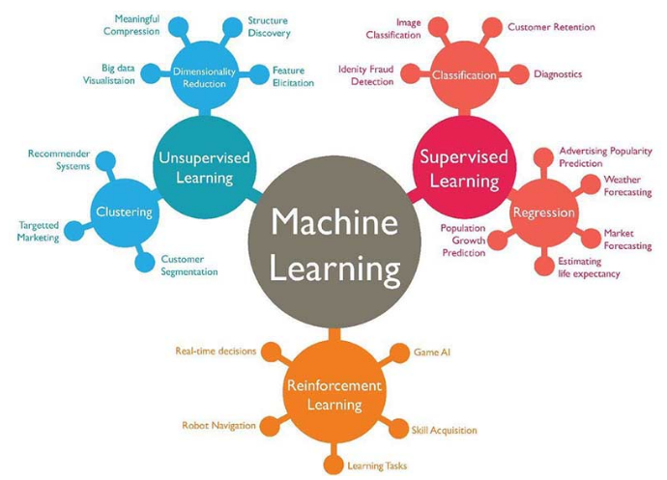
Data Science/ML/AI

Slide 19
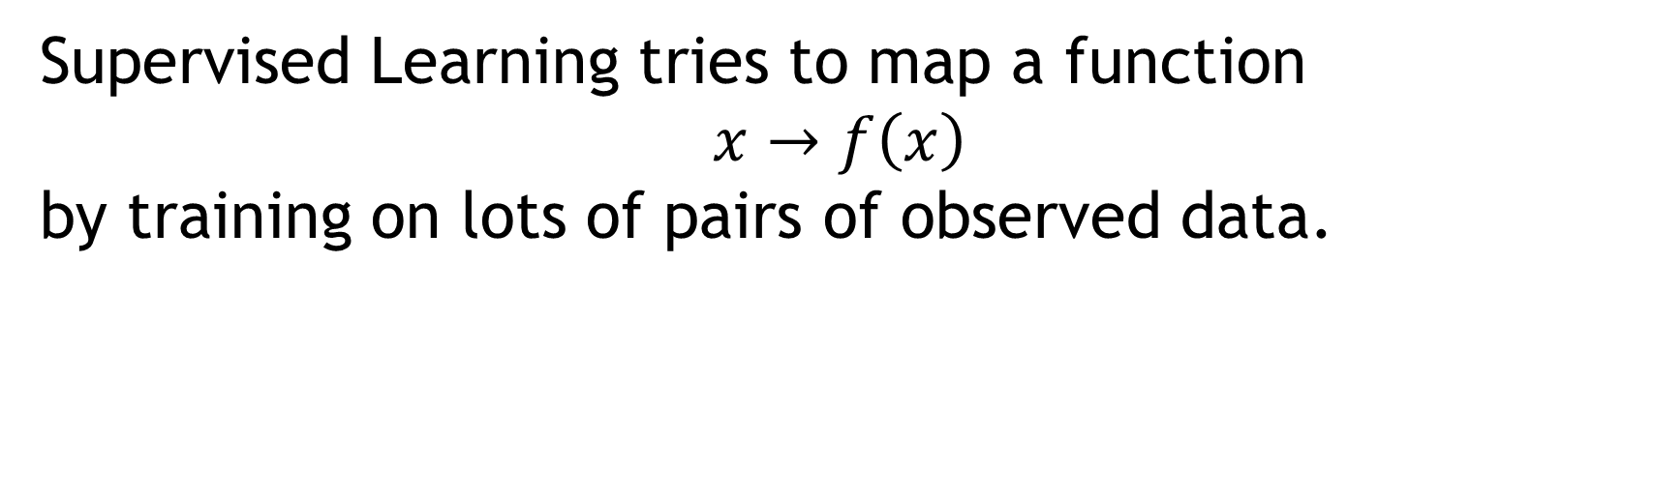
Data Science/ML/AI (Supervised Learning)
Supervised Learning tries to map a function $$x→f\left(x\right)$$
by training on lots of pairs of observed data.

Slide 20
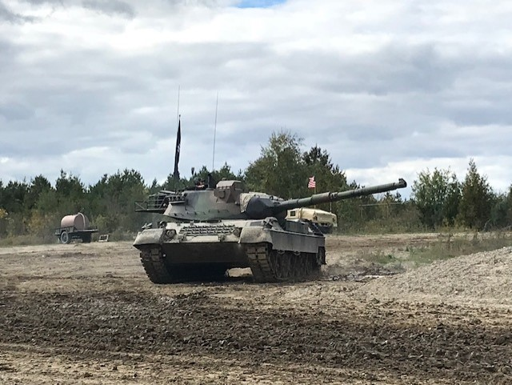

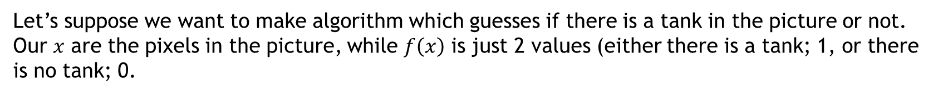
Data Science/ML/AI (Supervised Learning)
Let’s suppose we want to make algorithm which guesses if there is a tank in the picture or not.
Our $x$ are the pixels in the picture, while $f\left(x\right)$ is just 2 values (either there is a tank; 1, or there is no tank; 0.

Slide 21
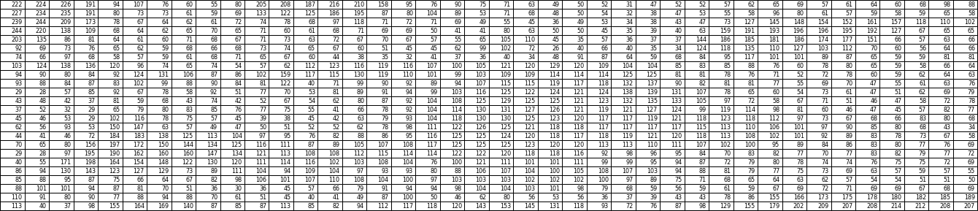
Data Science/ML/AI (Supervised Learning)
Pixels range from 0 to 255, where full white pixels are 255 and full black pixels are 0.
For each image the values of pixels are connected to $f\left(x\right)$ in some way. So ML algorithm will try to learn the connection by going through thousands and thousands of images.

Slide 22
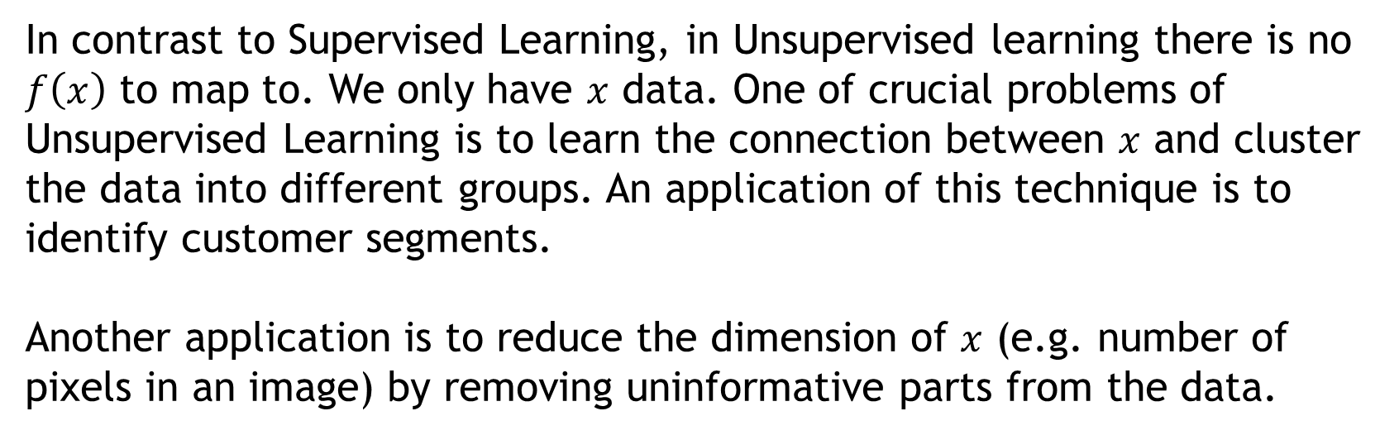
Data Science/ML/AI (Unsupervised Learning)
In contrast to Supervised Learning, in Unsupervised learning there is no $f\left(x\right)$ to map to. We only have $x$ data. One of crucial problems of Unsupervised Learning is to learn the connection between $x$ and cluster the data into different groups. An application of this technique is to identify customer segments.
Another application is to reduce the dimension of $x$ (e.g. number of pixels in an image) by removing uninformative parts from the data.

Slide 23
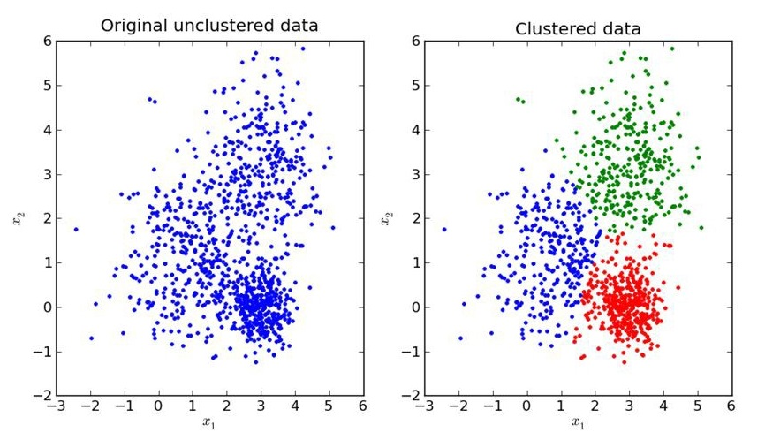
Data Science/ML/AI (Unsupervised Learning)
An example of clustering algorithm results

Slide 24
Data Science/ML/AI (Reinforcement Learning)
Main methodology of Reinforcement Learning is to define an environment, an agent and an objective.
After doing many experimentations the agent should learn how to achieve the objective in its environment.

Slide 25

Data Science/ML/AI (Reinforcement Learning)

Slide 26
Data Science/ML/AI (Reinforcement Learning)
Some facts
Reinforcement Learning has kind of both supervised and unsupervised components.
Nowadays Reinforcement Learning is mainly applied in games and it is doing exceptionally well in those tasks.
Reinforcement learning has huge potential but lots of research should be done in order to apply it in real life scenarios.

Slide 27

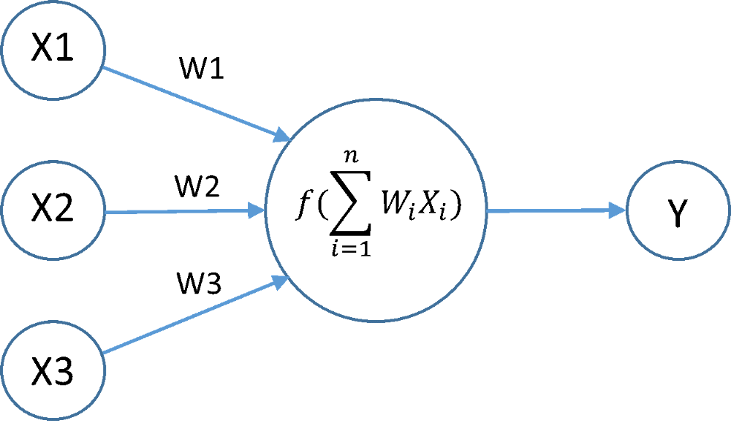
Data Science/ML/AI
You will also see the term Deep Learning which is the overall branch of ML that deals with Neural Networks which have multiple layers.
Not deep
Deep

Slide 28
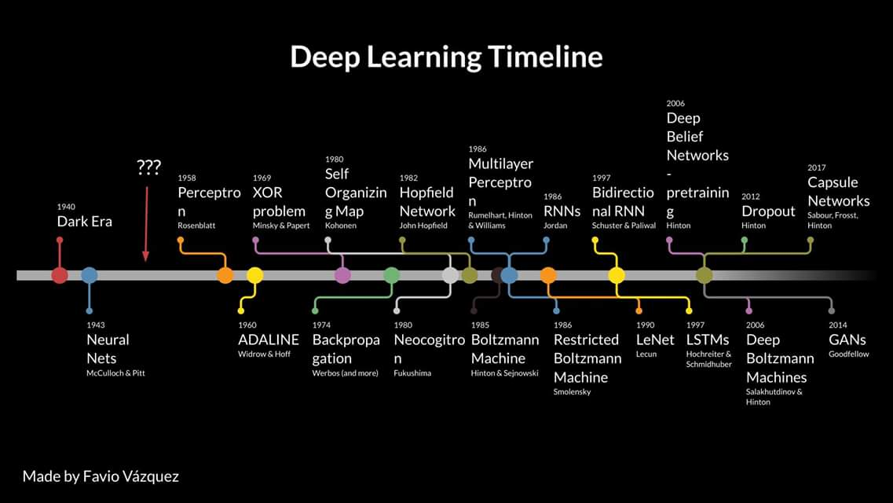

Slide 29
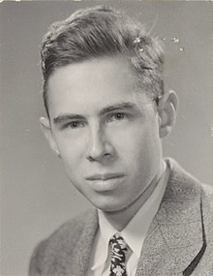
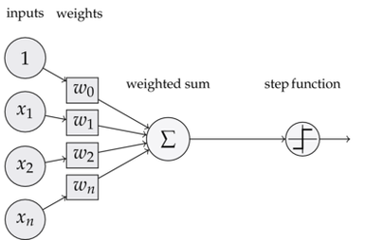
Brief history of ML
1950s – Frank Rosenblatt developed Perceptron, first ML algorithm.

Slide 31
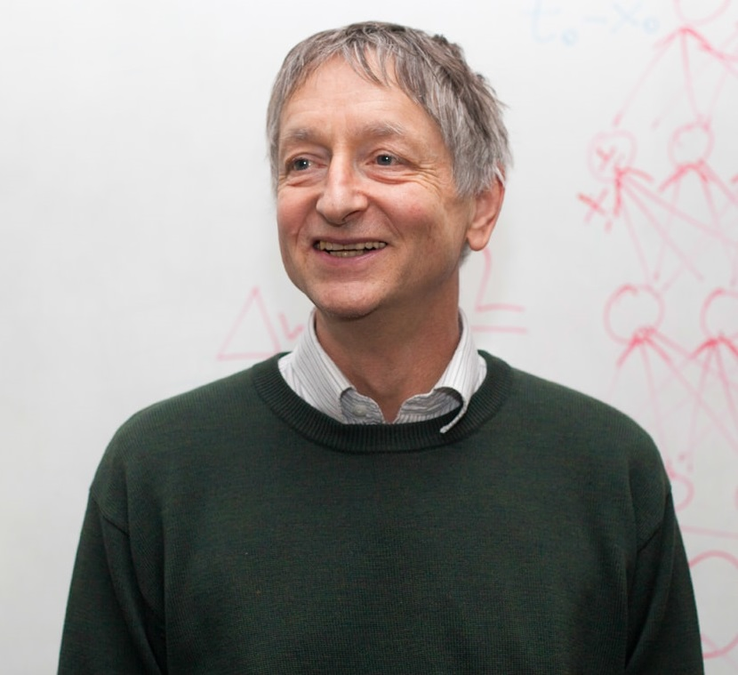
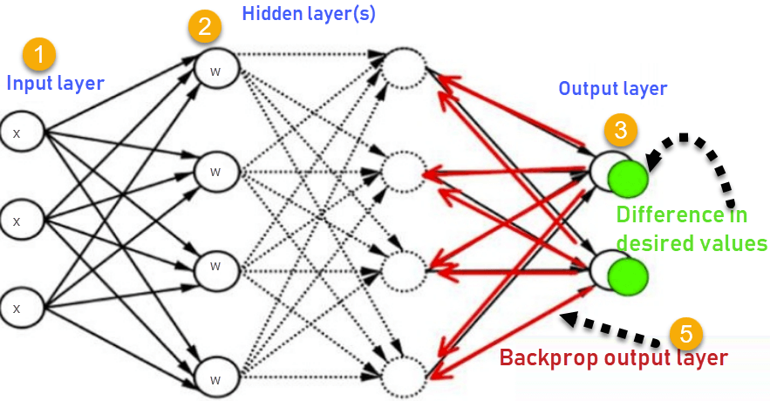
Brief history of ML
1980s - Geoffrey Hinton brought recognition to backpropagation algorithm.

Slide 32
Somewhere around here

Slide 33
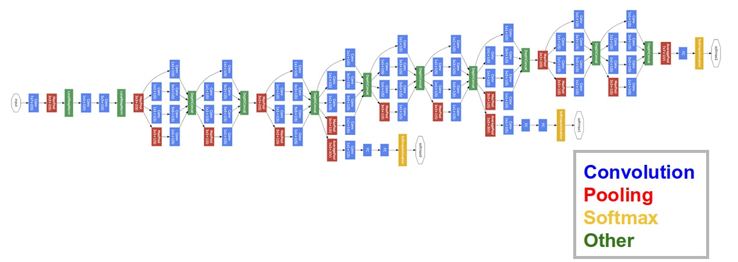
Brief history of ML
2012 – Big Boom of ML, Convolutional Neural Networks on ImageNet

Slide 34
Somewhere around here

Slide 35

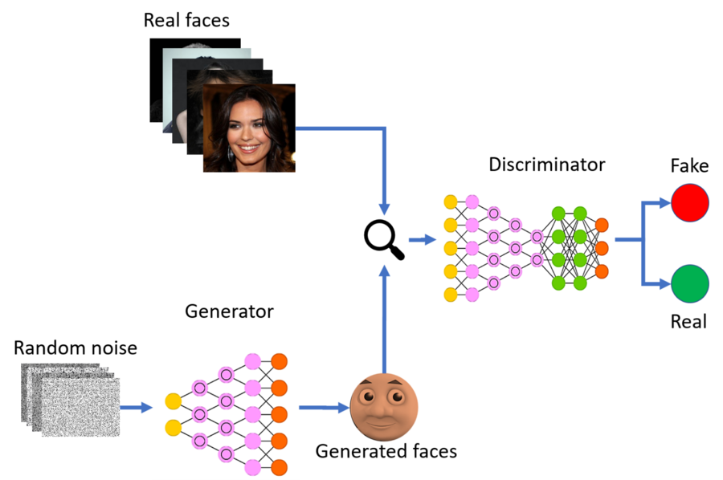
Brief history of ML
Ian Goodfellow created first Generative Adversarial Network

Slide 36
Current Achievements (seeing through wall)

Slide 37
Current Achievements (generating human faces)

Slide 38
Current Achievements (generating terrain)

Slide 39
Current Achievements (playing hide&seek)

Slide 40
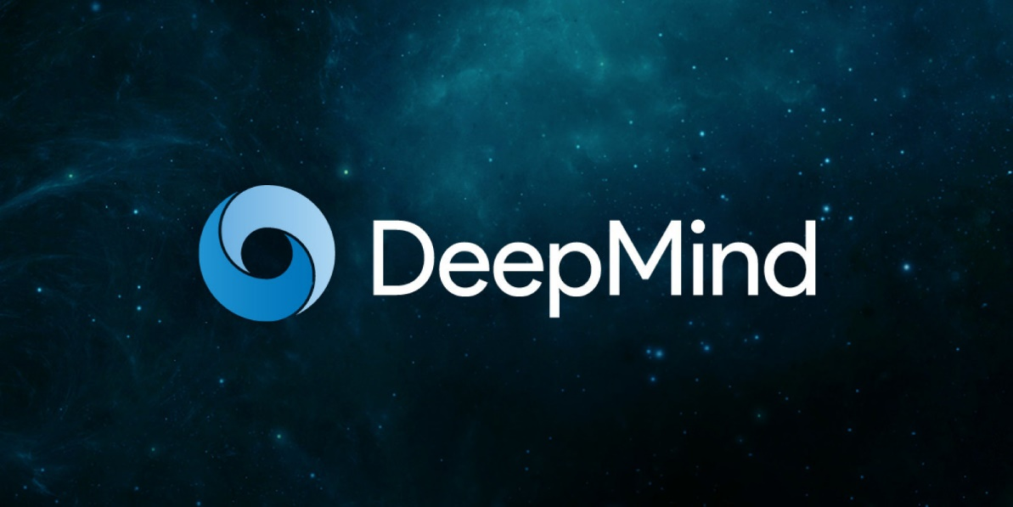
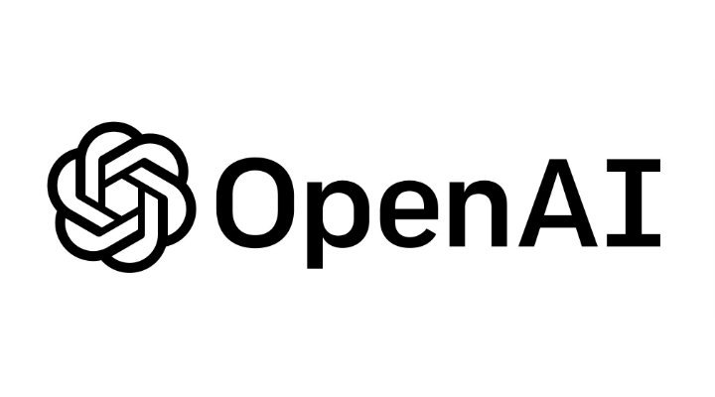
What’s Next?
Two most influential companies working on Artificial General Intelligence.
Their AI systems now beat humans in Go (Japanese board game), DOTA (cooperative videogame), StarCraft(real time strategy videogame)

Slide 41
What’s Next?
CEO of DeepMind Demis Hassabis believes it will take some time to AGI but we are on the right track.

Slide 42
Thank you!

